Slide 1
A French perspective on VW scandal-related litigation
General Public Release
AIDA Climate Change Working Party - Paris, December 2nd, 2015
Cedric Wells

Slide 2
Table of Contents / Agenda
Background
Inquiries in France
VW response
Civil vs. Criminal Law (France)
Individual & collective initiatives in France (NOT Class Actions!)
New business opportunities
« French » Class Actions

Slide 3
Background
18 Sep 2015: The U.S. EPA issued a notice of violation of the Clean Air Act to VW Group, after it was found that the automaker had intentionally programmed turbocharged direct injection (TDI) diesel engines to activate certain emissions controls only during laboratory emissions testing. The programming caused the vehicles' nitrogen oxide (NOx) output to meet U.S. standards during regulatory testing, but produce up to 40x higher NOx output in real-world driving.
29 Sep 2015: VW announced plans to refit up to 11M vehicles fitted with VW’s EA 189 diesel engines (VW, Audi, Skoda and SEAT) affected by the emissions violations scandal.
French governmental announcements
VW will have to return State subsidies as part of the bonus-malus scheme
Random antipollution inspections

Slide 4
Inquiries in France
Inquiries launched in Oct 2015
(Criminal): Paris Public Prosecutor (« enquête préliminaire pour tromperie aggravée sur une marchandise susceptible d’être dangereuse pour la santé ») - 2 bureaux involved
(Environment and Public Health) Public Office central de lutte contre les atteintes à l’environnement et à la santé publique (Oclaesp)
(Anticorruption) Office anticorruption de la police judiciaire (Oclciff)
(Administrative) Direction générale de la concurrence, de la consommation et de la répression des fraudes
Purpose of the inquiries
Establish the existence of the fraud/its prior knowledge by directors
Assess potential harm to customers (performance/power, fuel consumption, loss of car re-sale value, unavailability of car during recall, etc.)

Slide 5
VW response
France
United States
950,000 cars involved
All affected customers notified individually
They can verify whether their car is affected or not on a dedicated VW web site (enter chassis and date of latest registration numbers)
Voluntary recall to « refit » cars ("mesure de correction des écarts d'émission d'oxyde d'azote")
Reformating of electronic motor calculator (downloadable software adjustment)
Replacement of injectors and/or catalysers in some cases
VW will refund any tax benefit-related losses
Post-recall certificate will confirm cars are compliant with regulation (key for re-sale of cars)
482,000 cars involved
Financial compensation (goodwill package)
USD 500 pre-paid Visa card
USD 500 VW voucher
3 years of 24h roadside assistance

Slide 6
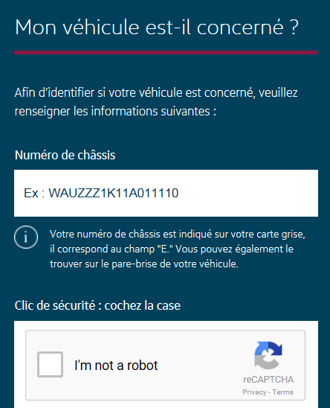
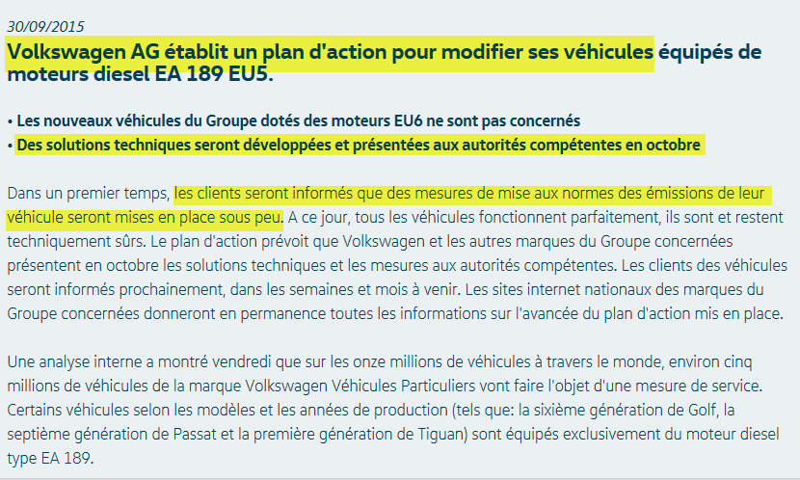
VW response in France (website)
https://informations.volkswagengroup.fr

Slide 7
VW response (rationale)
France
United States
50%+ cars sold are diesel
Diesel, a subsidised fuel (cheaper than gasoline; tax benefits)
EU-wide recall soon finalised
Fixes approved by the German motor transport authority (KBA)
With this approval, recall certification valid throughout the EU
Small population of diesel-fueled cars
Diesel more costly than gasoline
Cars were advertised as « clean diesel »
Clients invested in niche technology
Strategy appears to be to make cars compliant with type approval regulations which should solve the problem. Illegality of the software has not yet fully established.
Priority appears to be avoid mass litigation and to compensate losses via a package.

Slide 8
Civil vs. Criminal Law (France)
Civil Law
Various grounds available for breach of contract claims: garantie de conformité (art. L. 211-4 du Code de la consommation), manquement à l’obligation de délivrance conforme du vendeur (art. 1604 du Code civil), vice du consentement (art. 1109s du Code civil), garantie des vices cachés (art. 1641s du Code civil), etc.
Burden of proof on plaintiff:
Demonstrate that car does not comply with sales contract and/or hidden information on emissions was material to purchase decision
Challenge: no such information was mandatory/contained VW technical/advertising material
Criminal Law (Code Pénal)
Various grounds for fraud available: unfair commercial practice, deceptive advertising, forgery and counterfeiting, reckless endangerment, deceipt, complicity
Burden of proof: plaintiffs can rely on ongoing criminal investigations

Slide 9
Individual & collective initiatives in France (NOT Class Actions!)
Individual
Criminal action: several individual compaints filed on their behalf by same counsel (Marseille, Clermont-Ferrand)
Collective
Criminal action against VW (TGI de Paris)
AVIFA: 50+ car owners
CLCV: State-approved “Association de consommateurs” able to conduct Class Actions in France; encourages clients to file complaints before Court of juridiction in which car was purchased; template letters of complaint available
ONG Ecologie Sans Frontière
Collaborative efforts
class-action-volkswagen.eu: group of consumers (9,000 @ Nov 15); hopes to become a State-approved Association de consommateurs

Slide 10
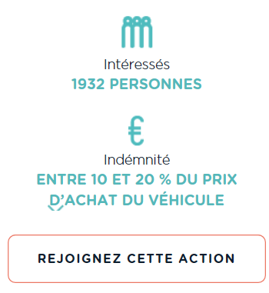
New business opportunities (lawfirms)
Avocats Actions Conjointes platform (Paris Bar)
EUR 600,00 fee agreement (negotiable!) + success fees
Opt in by 30 Dec 2015
Aim is to obtain 10-20% purchase price back
Le dépôt d’une plainte fera l’objet d’une convention d’honoraires forfaitaire pour un montant fixé par principe à 500 euros HT (soit 600 euros TTC) pouvant être personnalisée selon la situation spécifique des plaignants (nombre de véhicules, cas particulier, etc)
Pièces à joindre
Carte Nationale d’identité (ou équivalent)
Copie du certificat d’immatriculation du véhicule
Facture d’achat du véhicule
http://avocats-actions-conjointes.com/affaire-volkswagen

Slide 11
New business opportunities (class action management)
weclaim.com
Paris-based start-up web platform which « brings lawyers and claimants together »
No legal services provided
Join a class action in a few clicks
No upfront costs; no win, no fee
Success fees: litigation fees awarded or agreed in settlement + 33% of amounts allocated (or the value of non-financial counterparties)
Want VW clients to be able to return car/obtain refund of sale price
Aim is to try and reach settlement agreements before initiating legal action

Slide 12
« French » Class Actions
Loi Hamon of 17 March 2014 (in force 18 March 2014)
Allows 2+ individual consumers (no corporations or professionals; no shareholders) in the same or similar situation to bring a class action to recover damages for the material loss suffered for breaches of contractual and/or statutory duties by professionals.
Action must be brought via a State-approved consumer association (15 currently).
Repair not punish
Remedies for material loss only
Damages for physical and/or moral loss available from ordinary remedies under law
Opt with publicity basis (vs. opt out in the US): positive act required from consumers willing to join in the action.
Lawyers remuneration can not depend 100% on success fees

Slide 13
VW Class Action in France (hurdles)
6 class actions so far with limited success
Will the CLCV action turn into a Class Action?
Unlikely to be initiated before VW fraud is established
Economic prejudice
Experts’ opinion required
Will vary from one plaintiff to another/specific to each car (state, mileage)
If VW response is satisfactory, VW class action will probably not be pursued
Lenghthy litigation
Legal fees and costs vs. claim value
VW may offer attractive compensation

Slide 15
Legal notice
©2015 Swiss Re. All rights reserved. You are not permitted to create any modifications or derivative works of this presentation or to use it for commercial or other public purposes without the prior written permission of Swiss Re.
The information and opinions contained in the presentation are provided as at the date of the presentation and are subject to change without notice. Although the information used was taken from reliable sources, Swiss Re does not accept any responsibility for the accuracy or comprehensiveness of the details given. All liability for the accuracy and completeness thereof or for any damage or loss resulting from the use of the information contained in this presentation is expressly excluded. Under no circumstances shall Swiss Re or its Group companies be liable for any financial or consequential loss relating to this presentation.

